Slide 1

Learning Intentions: Today we are finishing our learning about Job and working on an essay about suffering in Judaism.
Success Criteria: By the end of the lesson you will:
. Have analysed the story of Job.
. Have learnt about a way to structure an essay.
. Have begun to write an essay using this method..

Slide 2
Judaism
Beliefs
• beliefs about God
• nature of human beings: yetzer tov; yetzer harah; free will; suffering
• beliefs about Covenant
• judgement; the Messiah; the Messianic Age; Olam Ha’ba
Practices
• living according to the Commandments
• Rosh Hashanah; Yom Kippur
• worship: Shabbat; synagogue

Slide 3
Analysis of Job
1. Retell the story of Job in no more than 30 words. (1)
2. Why do you think God got annoyed when Job questioned him? (2)
3. Why do you think God rewarded Job in the end? (2)
4. How can the story of Job explain the relationship between good (God) and evil (Satan)? (2)
2. How might a Jew use the story of Job to find comfort when suffering? (2)
3. Do you think the story of The Fall or the story of Job explains the existence of suffering best? (2)
4. Is God responsible for the death of people in the book of Job? (2)
Homework
Due: Thursday 9th Sept

Slide 4
Skills jotter
Analyse the relationship between beliefs about free will and suffering.
10 marks

Slide 5

Analysis
Analysis involves doing something with the factual information you’ve used in your KU mark. What I know shows that….
It involves showing links between the ideas/beliefs, explaining consequences, implications….
This might be identifying and explaining relationships between different beliefs, or explaining consequences and causes.
So, for example, if you were to write down a Torah quote, and explain what it means for a KU mark, to get an analysis mark from it, you could explain what impact it has on a Jews day-to-day life, or how the quote links to other beliefs and practices in Judaism.

Slide 6

Analysis Sentence starters.
“This shows…”, “This implies…”, “This means…”,
“This is strong/weak because…”, “This is effective because…”
“An advantages of this is…..”
“This results in……” “A consequence of this might be……”

Slide 7
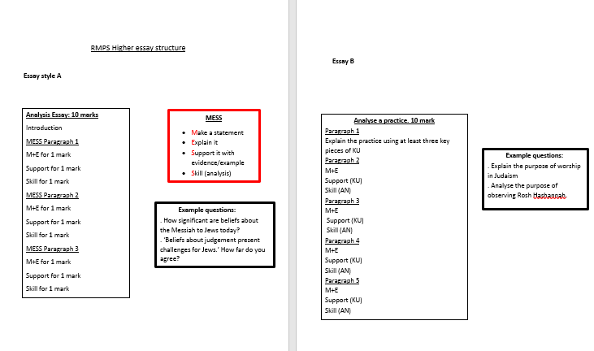
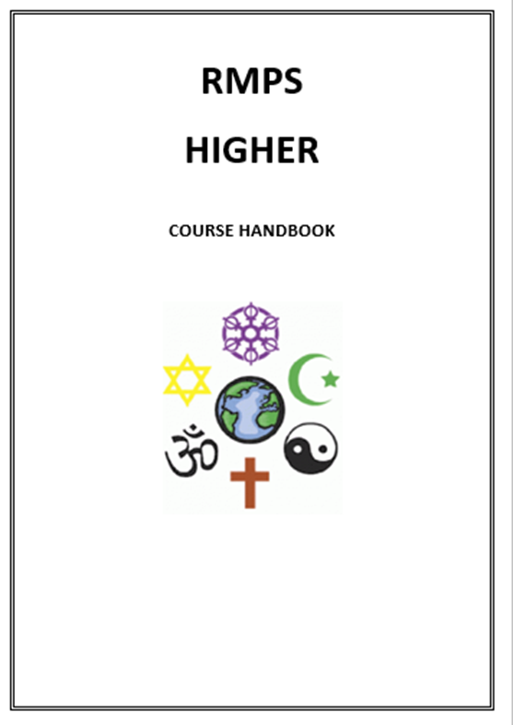
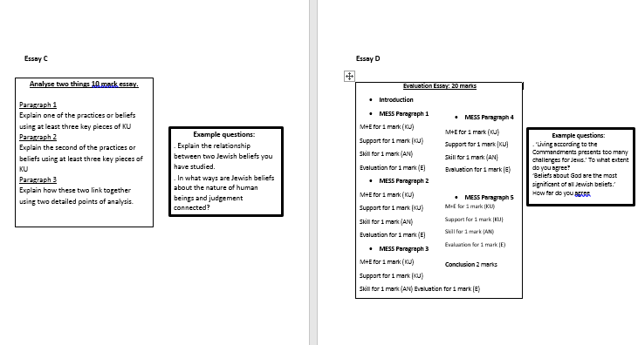

Slide 8
Analyse the relationship between beliefs about free will and suffering.
Analyse two things 10 mark essay.
Paragraph 1
Explain the first of the practices or belief using at least three key pieces of KU
Paragraph 2
Explain the second of the practices or belief using at least three key pieces of KU
Paragraph 3
Explain how these two link together using two detailed points of analysis.
6 marks KU
4 marks AN

Slide 9
MESSY
Make a statement
Explain it
Support it with evidence/example
Skill (analysis)
Your opinion (evaluation)
MESS
Make a statement
Explain it
Support it with evidence/example
Skill (analysis)

Slide 10
Write a paragraph about free will.
It must include at least one quote and two pieces of detailed KU
“ Free will is the belief that….
Write a paragraph about Suffering.
It must include at least one quote and two pieces of detailed KU
“ Suffering is the belief that….
Write a paragraph about the link between free will and suffering.
It must include at least two detailed points of analysis
“ Free will and suffering are linked…

Slide 11
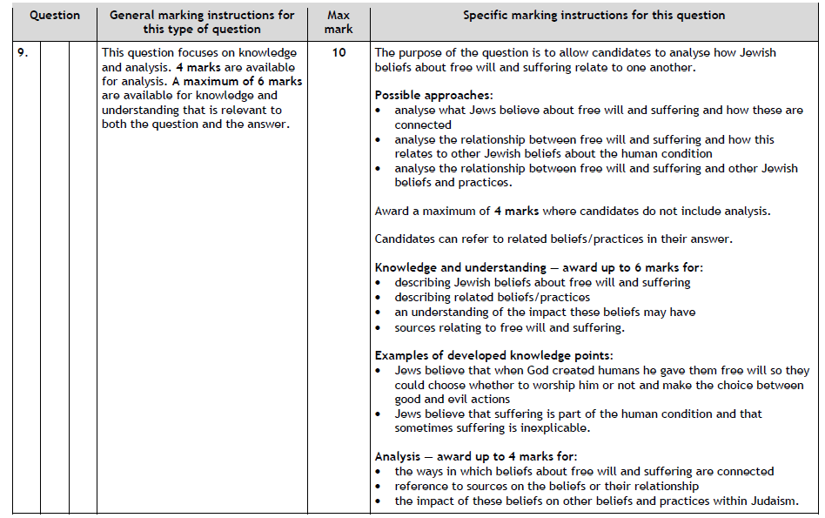
Analyse the relationship between beliefs about free will and suffering. 10 marks

